Slide 1
OHTEIA Annual Meeting
February 22, 2020
Tree Stand Safety:
An Analysis of Mid-West Falls

Slide 2
Objectives
List the top 5 causes of tree stand falls.
Compare and contrast falls from different types of tree stands.
Explain the proper use of a Fall Arrest System.
Identify new teaching strategies on Tree Stand Safety.
Define the “ABC’s of Tree Stand Safety.
Understand the role the Treestand Manufacutures Association (TMA) plays in tree stand safety.
Identify safe vs. non-safe tree stand set-ups.

Slide 3
TSSA Foundation’s Mission
Significantly reduce tree stand incidents through promotion, education, and best practices.
Long Term Goal:
Reduce tree stand fall incidents by 50% (2023).
Currently @ 46.5%

Slide 4
Our Partners….

Slide 5
What do the #’s tell us?

Slide 6
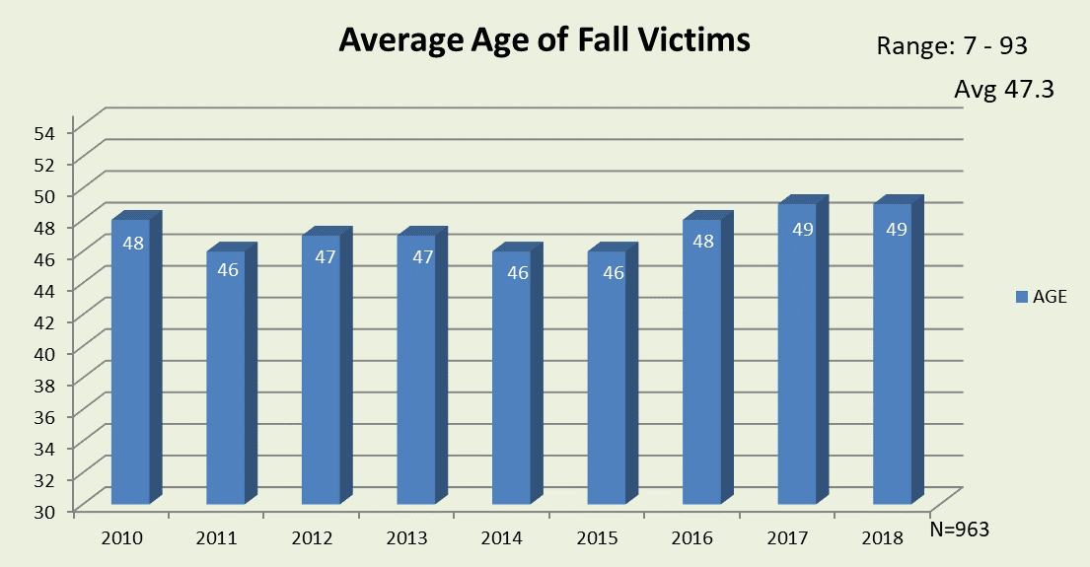
Fall Victim Age
Mid-west Avg:
47
Range: 10 - 96

Slide 7
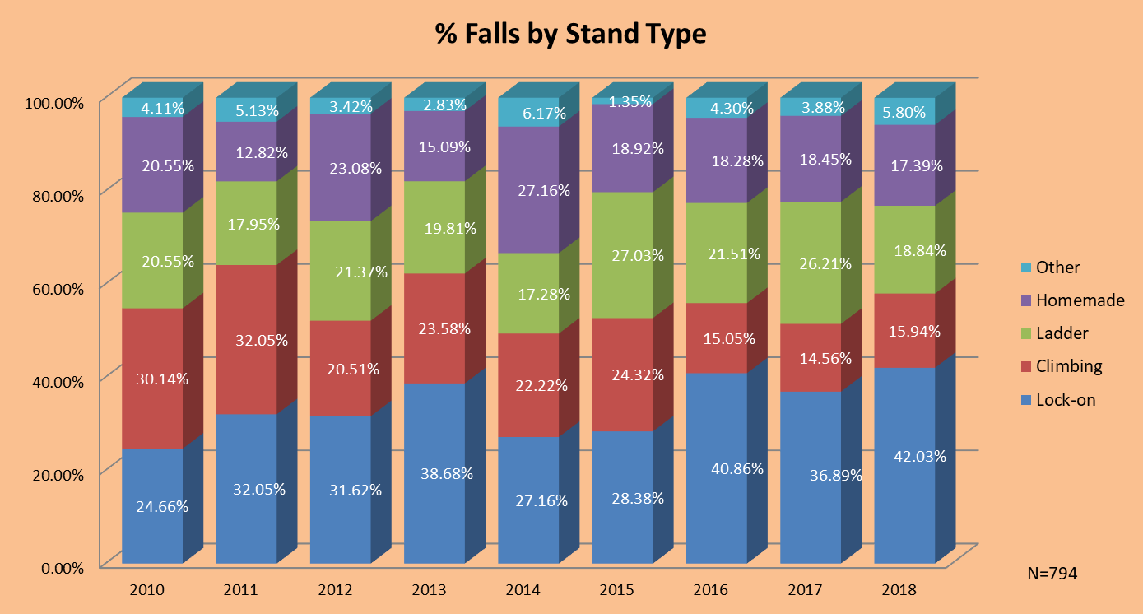
Stand Type

Slide 8
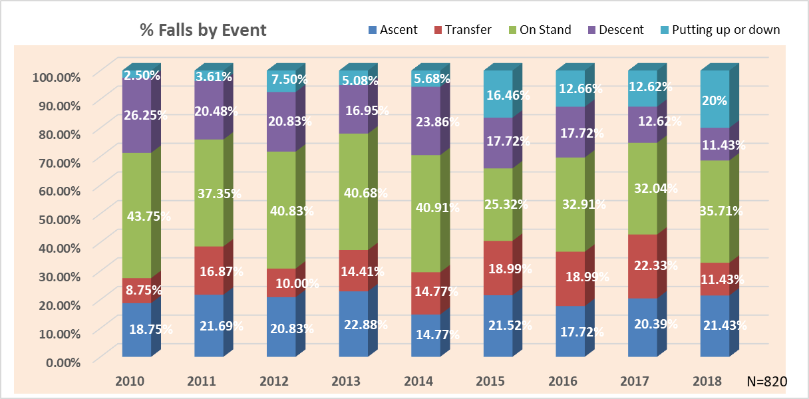
Falls by Event
N=291

Slide 9
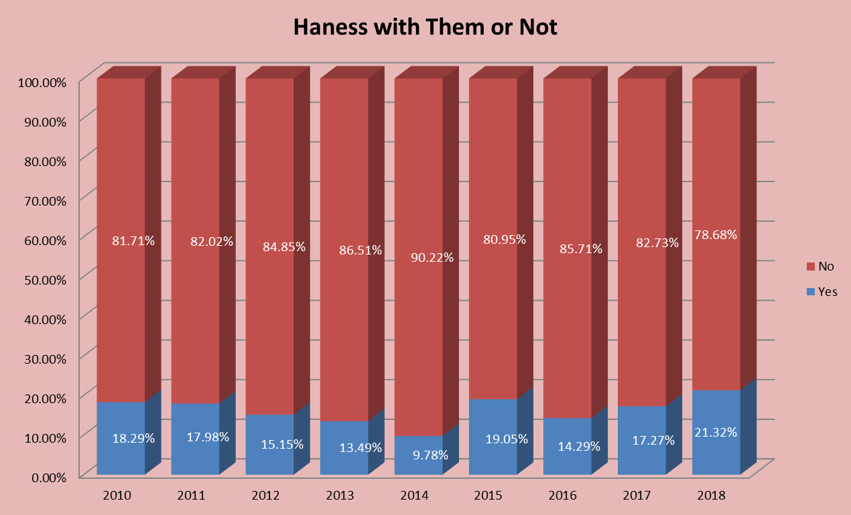
Harness with or without
1 out 5 additional SHOULD NOT have fallen!
N=306

Slide 10
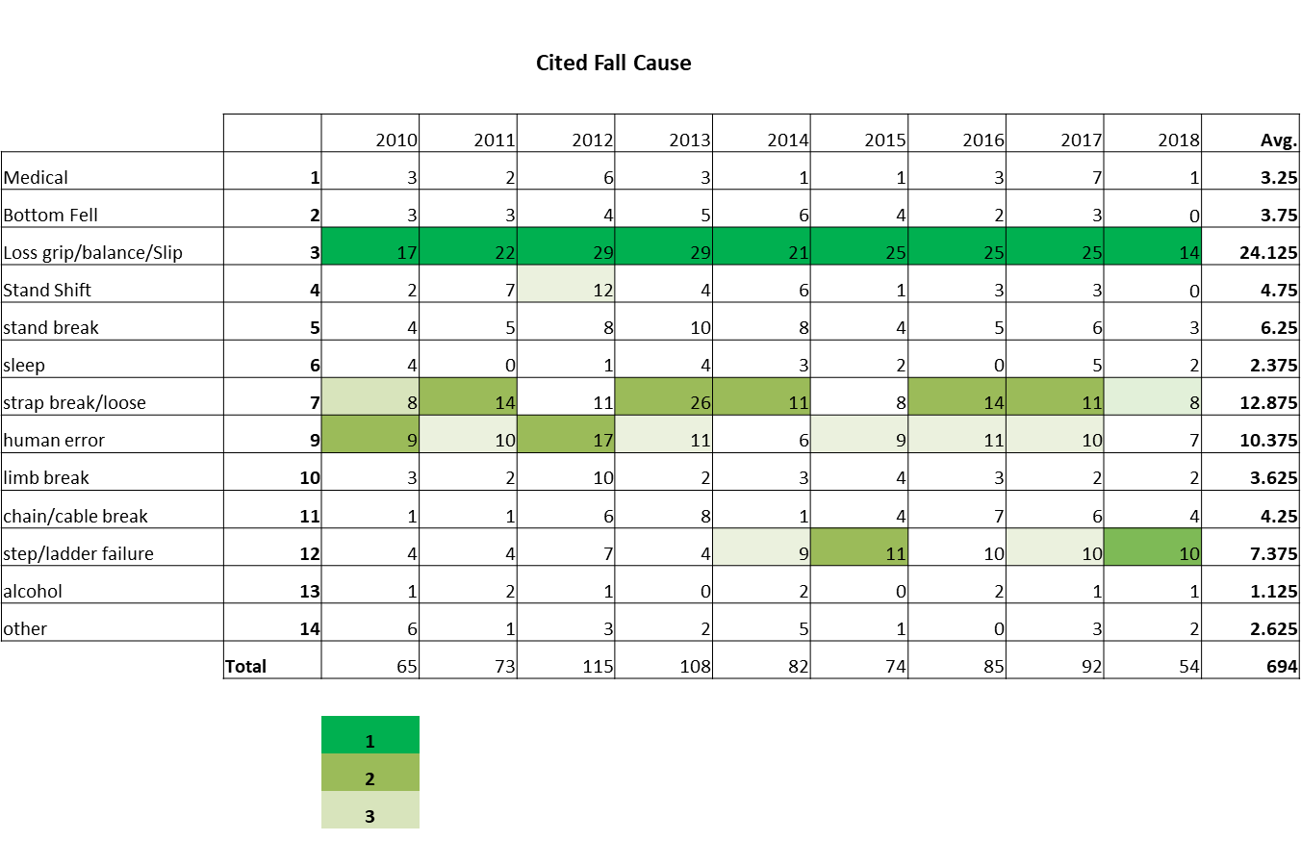
Top Causes
 |  | 2010 | 2011 | 2012 | 2013 | 2014 | 2015 | 2016 | 2017 | 2018 | Total
Medical | 1 | 1 |  | 2 | 1 |  |  | 1 | 1 |  | 6
Bottom Fell | 2 | 1 |  | 2 | 1 |  | 2 | 3 | 1 |  | 10
Loss grip/balance/Slip | 3 | 3 | 10 | 8 | 4 | 8 | 5 | 7 | 9 | 4 | 20
Stand Shift | 4 |  | 4 | 5 | 3 | 1 |  | 1 | 1 |  | 15
stand break | 5 |  | 2 |  | 1 | 3 |  | 4 | 2 | 2 | 14
sleep | 6 | 2 |  |  | 2 | 3 | 1 |  | 2 |  | 10
strap break/loose | 7 | 2 | 2 | 3 | 14 | 7 | 3 | 5 | 5 | 3 | 44
human error | 9 |  |  | 2 | 3 | 2 | 5 | 3 | 3 | 5 | 23
limb break | 10 |  | 1 | 1 | 1 | 2 | 3 | 3 | 2 |  | 13
chain/cable break | 11 |  |  |  | 2 | 1 | 2 | 4 | 2 | 2 | 13
step/ladder failure | 12 |  |  |  | 2 | 1 | 6 | 8 | 5 | 4 | 26
alcohol | 13 | 1 |  |  |  | 2 |  |  | 1 |  | 4
other | 14 | 1 |  |  |  | 1 | 1 |  | 1 | 1 | 5
 | Total | 11 | 19 | 23 | 34 | 31 | 28 | 39 | 35 | 21 | 241
N=241

Slide 11
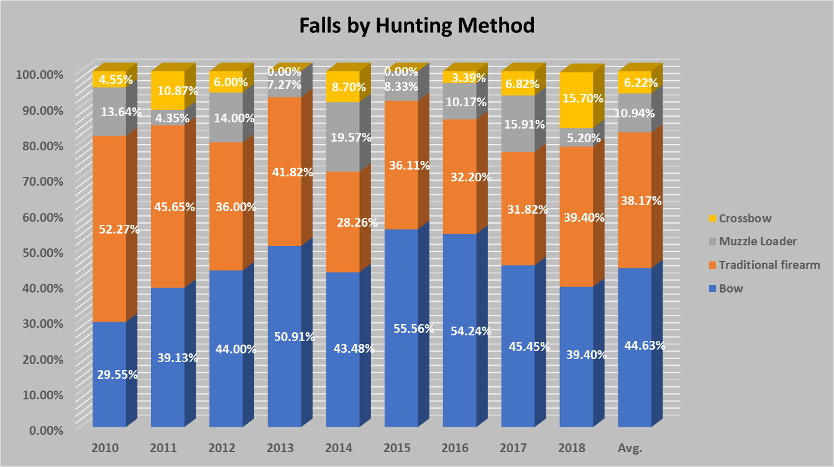
Hunting Method

Slide 12
Injury v. Fatality
 | 2010 | 2011 | 2012 | 2013 | 2014 | 2015 | 2016 | 2017 | 2018 | Totals
Injury | 13 | 24 | 42 | 36 | 30 | 35 | 57 | 36 | 23 | 296
Fatality | 2 | 0 | 3 | 1 | 1 | 0 | 1 | 3 | 0 | 11
total | 15 | 24 | 45 | 37 | 31 | 35 | 58 | 39 | 23 | 307
% Fatalilty | 13.33% | 0 | 6.66% | 2.70% | 3.22% | 0.00% | 1.72% | 7.69% | 0.00% | 3.58%

Slide 13
Best Practices and Techniques

Slide 14
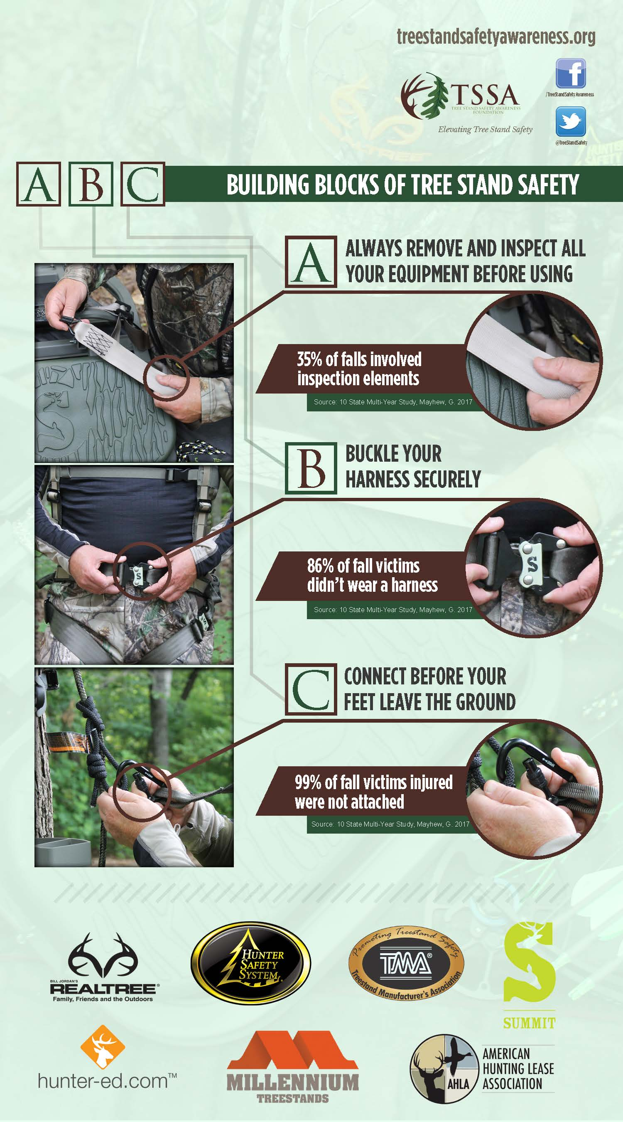
Keep it
Simple
Education Infographic

Slide 15
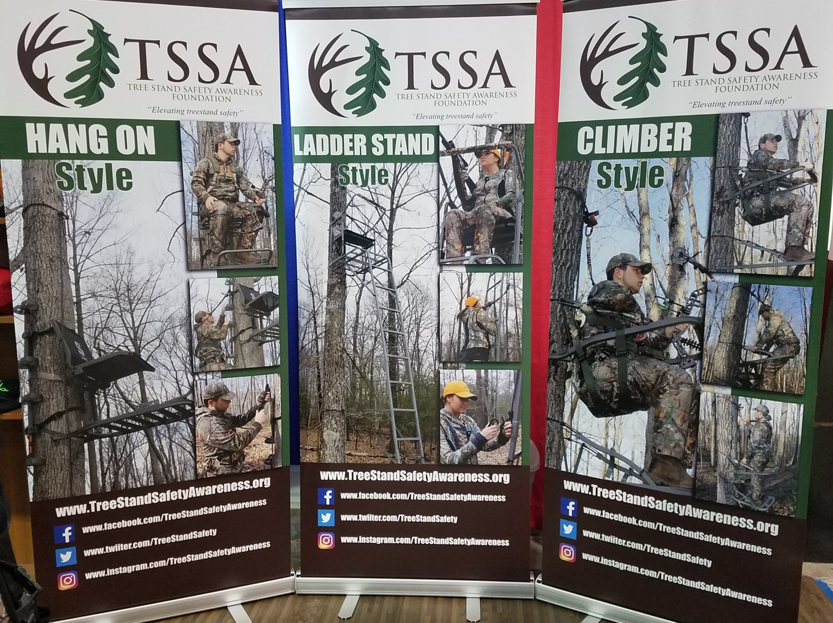
Educational Best Practices

Slide 16
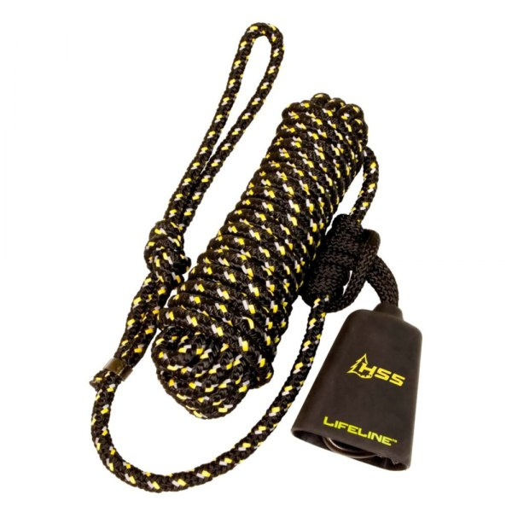
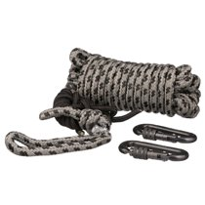
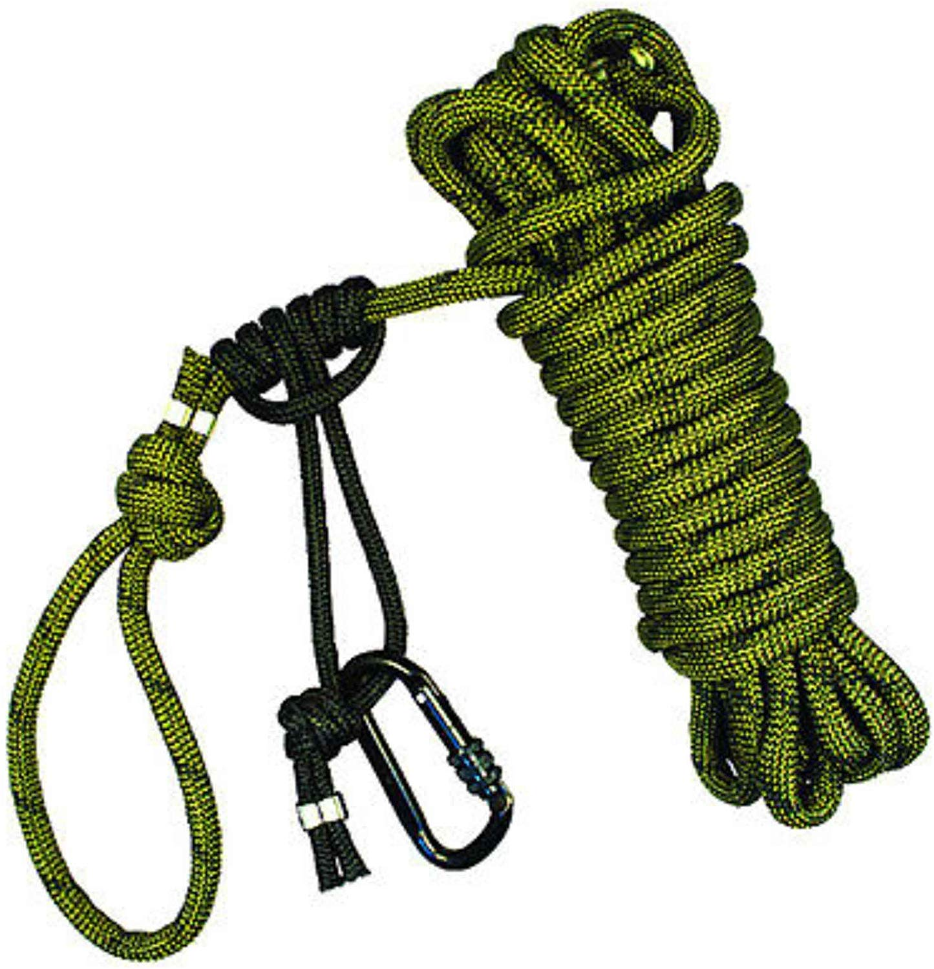
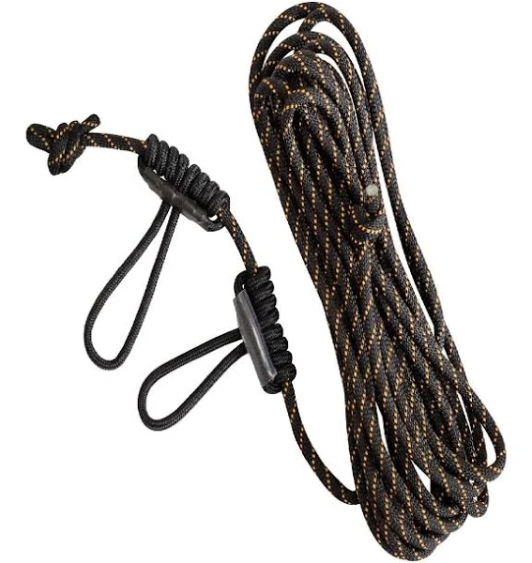
Rope Safety Lines
Summit Tree Stands
Hunter Safety System
Millennium Tree Stands
Muddy Tree Stands

Slide 19
Tree Stand Manufacturer’s (TMA)Role
January 1, 2016 TMA members’ products are required to meet the current ASTM standards
TMA Does NOT have Standards
TMA Disclaimer
Any product listed on this website indicates that the TMA has been provided with an acknowledgement demonstrating that a representative production model has been tested by a third party testing firm and certified by that testing firm to meet or exceed industry standards recognized by TMA. TMA is not involved in and thus not responsible for the design, quality control and/or safety of the product or end user. It is the responsibility of each end user to safely use the product as it was intended to be used and according to manufacturer’s instructions.

Slide 20
Where are the RESOURCES?

Slide 21
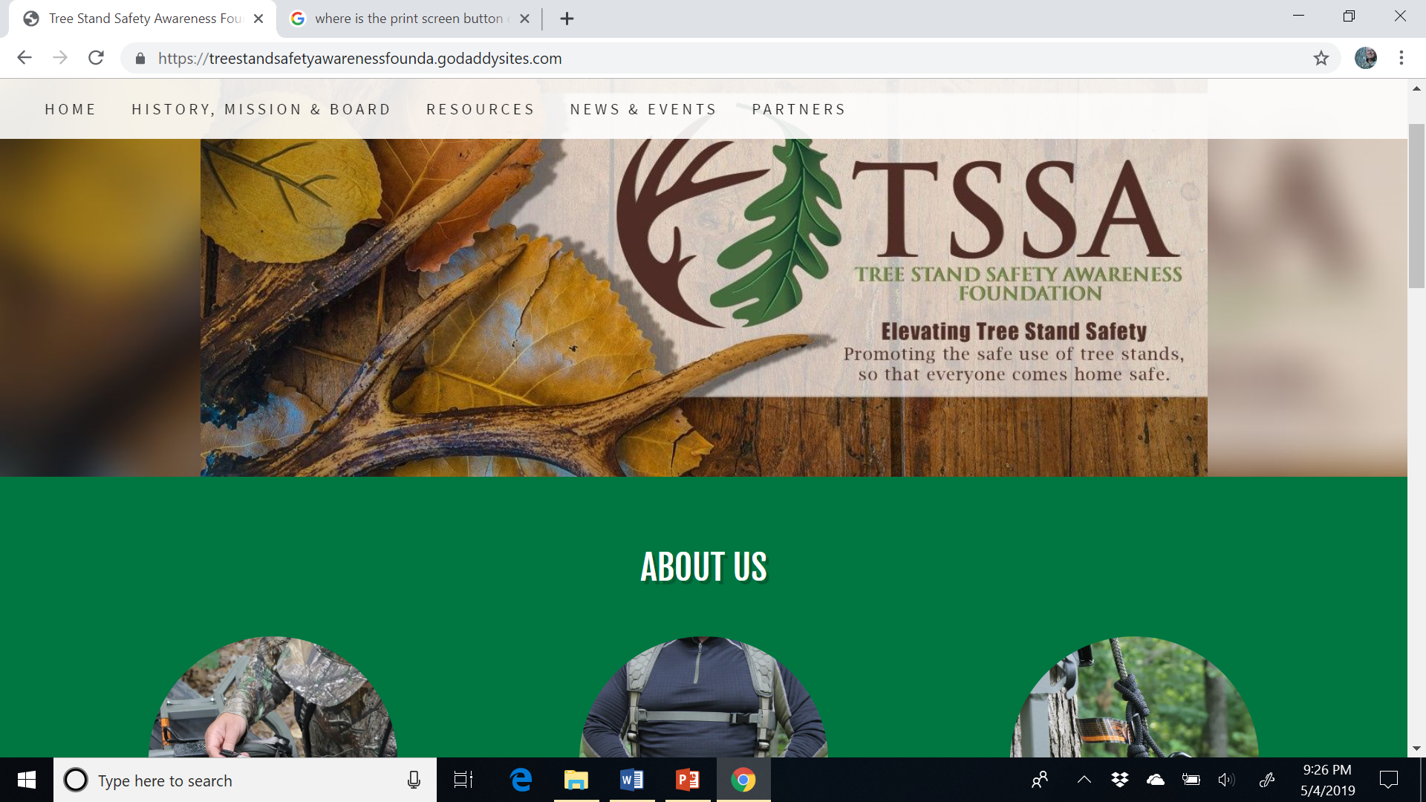

Slide 22
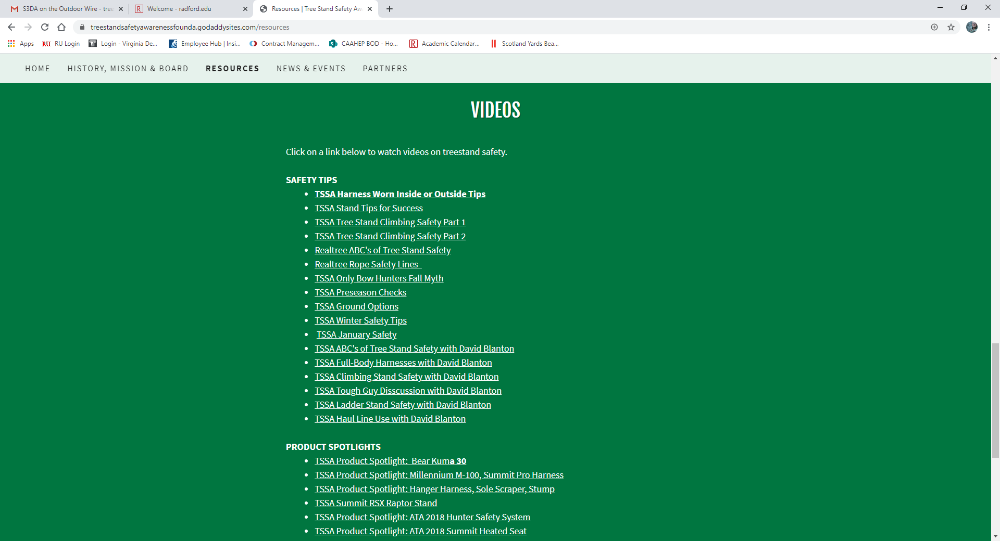

Slide 23
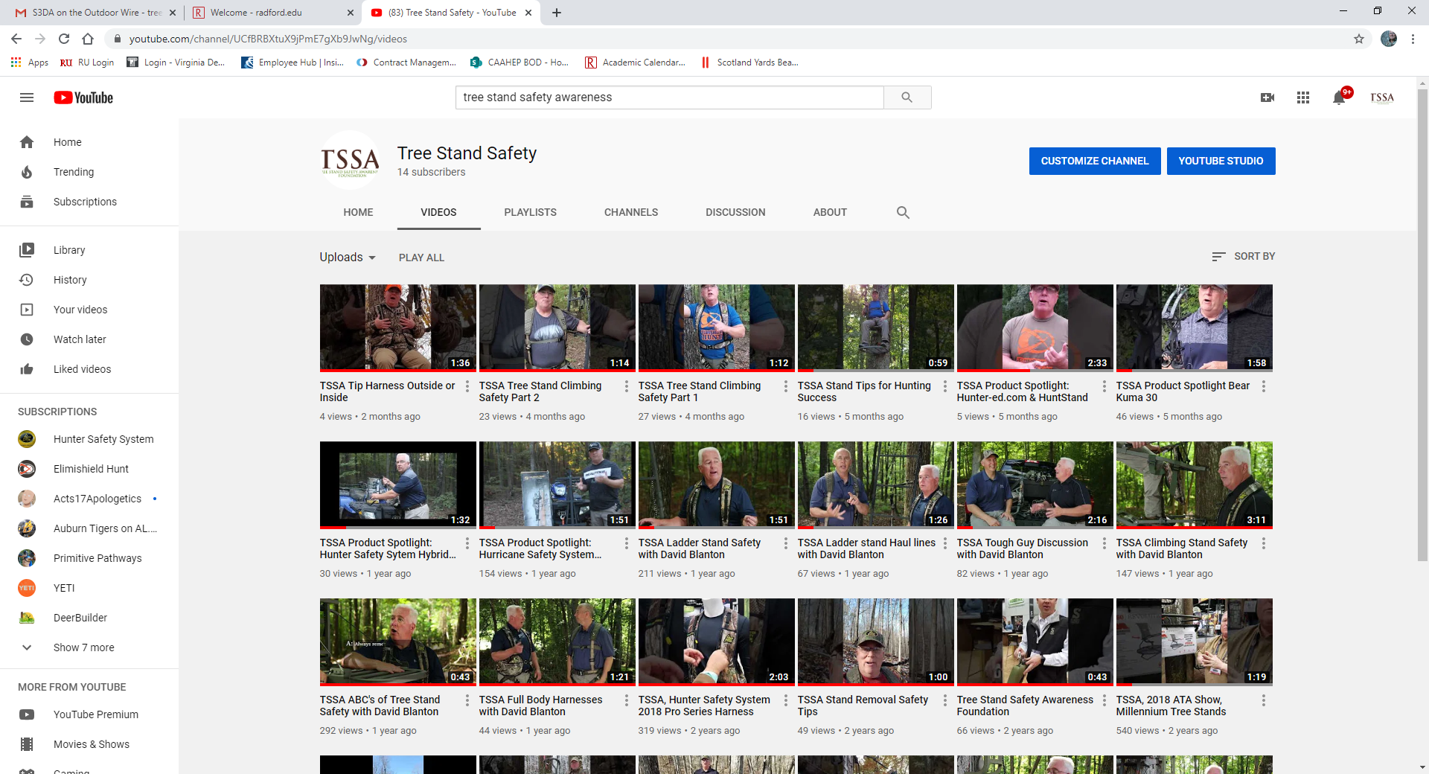

Slide 24
Let’s Have Some FUN!

Slide 25
SAFE or NOT?

Slide 26
SAFE or NOT?

Slide 27
SAFE or NOT?

Slide 28
SAFE or NOT?

Slide 29
SAFE or NOT?

Slide 30
SAFE or NOT?

Slide 31
SAFE or NOT?

Slide 32
We do this so…
Everyone Comes Home SAFE!

Slide 33
How Can We Help You?

Slide 34
Questions/Comments
Contact Information
TSSA Foundation
Glen Mayhew, DHSc
treestandsafe@gmail.com
540-526-5157
YouTube Channel: Tree Stand Safety Awareness

